Slide 1
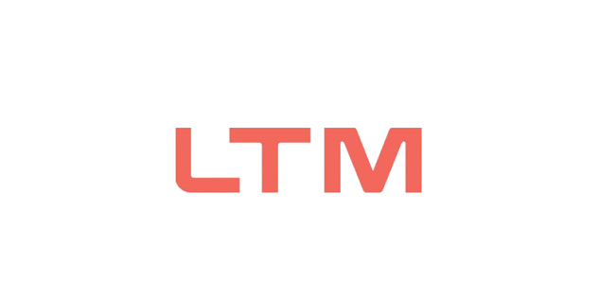

MTech Program
Advanced Industry Integrated Programs
Jointly offered by University and LTIMindTree
Review III
Project Title I
Self Corrective RAG with Adaptive Evidence Verification for
Hallucination Resistant Answer Generation
SOWMIYA C
T9954
CRESCENT COLLEGE
Knowledge partner | Implementation partner

Slide 2

Self Corrective RAG With Adaptive Evidence Verification
Introduction
Retrieval-Augmented Generation (RAG) combines information retrieval with large language models to generate accurate answers.
Traditional RAG may retrieve irrelevant or insufficient evidence, leading to hallucinated responses.
This project introduces a self-corrective RAG system that verifies retrieved evidence before generating the final answer.
The system improves answer accuracy, reliability, and faithfulness through adaptive evidence verification and correction.

Slide 3
Self Corrective RAG With Adaptive Evidence Verification
Objective
To develop a self-corrective Retrieval-Augmented Generation (RAG) system.
To retrieve relevant and reliable evidence for user queries.
To verify the retrieved evidence before generating answers.
To identify and correct hallucinated or unsupported responses.
To improve answer accuracy, faithfulness, and reliability.

Slide 4
Self Corrective RAG With Adaptive Evidence Verification
Module name
1. Dataset Collection & Preprocessing
Collect the HotpotQA dataset.
Clean and preprocess questions, answers, and supporting documents.
Split the data into suitable training/testing sets.
2. Document Processing & Vector Database
Convert documents into chunks.
Generate embeddings using Sentence Transformers.
Store embeddings in ChromaDB for semantic retrieval.

Slide 5
Self Corrective RAG With Adaptive Evidence Verification
Modules to cover
3. Query & Evidence Retrieval
Accept the user's question.
Retrieve the most relevant document passages from the vector database.
4. Adaptive Evidence Verification
Check the relevance and sufficiency of retrieved evidence.
Identify irrelevant or insufficient passages.

Slide 6
Self Corrective RAG With Adaptive Evidence Verification
Modules to cover
5. Self-Correction & Answer Generation
Generate an answer using verified evidence.
If evidence is insufficient, re-retrieve or correct the response.
6. Evaluation & User Interface
Evaluate accuracy, faithfulness, retrieval relevance, and hallucination reduction.
Develop a simple Stream lit interface for users to ask questions and view answers.

Slide 7
Self Corrective RAG With Adaptive Evidence Verification
Problem Statement
• Traditional Large Language Models often generate responses without validating factual correctness.
• Generated answers may contain unsupported information, leading to hallucinations.
• Users cannot easily determine whether an answer is backed by reliable evidence.
• Existing RAG systems retrieve information but may still produce inaccurate responses.
• A reliable mechanism is required to verify evidence, detect hallucinations, and provide trustworthy answers.

Slide 8
Self Corrective RAG With Adaptive Evidence Verification
Methodology
Document Collection and Preprocessing
  Collect source documents and clean the text for indexing.
Knowledge Base Creation
  Generate embeddings and store documents in Chroma DB for efficient retrieval.
Question Retrieval and Answer Generation
  Retrieve relevant document chunks and generate answers using an LLM.
Adaptive Evidence Verification
  Validate generated answers against retrieved evidence and assign a verification score.
Self-Correction and Evaluation
  Re-retrieve information, regenerate answers when verification fails, and evaluate performance using test questions.

Slide 9
Self Corrective RAG With Adaptive Evidence Verification
Approach/Algorithms/Tools
Approach
• Developed a Self-Corrective RAG framework that retrieves relevant information, verifies generated responses, and reduces hallucinations through iterative correction.
Algorithms
Semantic Retrieval using vector embeddings and ChromaDB to fetch relevant documents.
Retrieval-Augmented Generation (RAG) to generate context-aware answers from retrieved evidence.

Slide 10
Self Corrective RAG With Adaptive Evidence Verification
Approach/Algorithms/Tools
Algorithms
Adaptive Evidence Verification to validate generated responses against supporting documents.
Hallucination Detection to identify unsupported claims in generated answers.
Self-Correction Loop to refine responses through re-retrieval and verification.
Tools
• Python, Stream lit, Fast API, Chroma DB, Lang Chain, Sentence Transformers, Hotpot QA, GitHub, Railway, Stream lit Cloud.

Slide 11
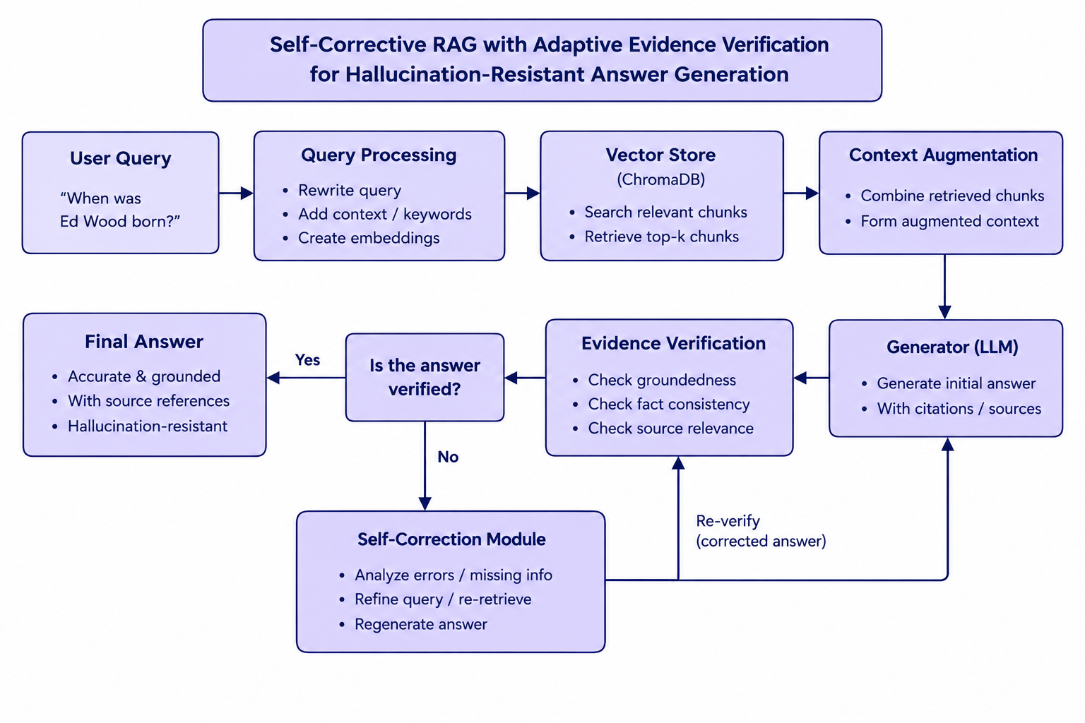
Self Corrective RAG With Adaptive Evidence Verification
Pipeline structure
User Query
↓
Document Retrieval
↓
Answer Generation
↓
Evidence Verification
↓
Hallucination Detection
↓
Self-Correction Loop
↓
Final Verified Answer

Slide 12
Self Corrective RAG With Adaptive Evidence Verification
Findings and Results
• Adaptive Evidence Verification successfully identified whether generated answers were supported by retrieved evidence.
• Hallucination Detection effectively detected unsupported claims and prevented unreliable responses.
• The Self-Correction mechanism improved answer quality by re-retrieving and refining responses.
• Semantic retrieval from ChromaDB enabled relevant context selection for question answering.
• The integrated framework produced more trustworthy and evidence-grounded responses compared to direct answer generation.

Slide 13
Self Corrective RAG With Adaptive Evidence Verification
Conclusion
• The proposed system effectively combines retrieval, verification, and correction to improve response quality.
• Adaptive evidence verification helps ensure answers are supported by relevant information.
• Hallucination detection enhances the reliability and trustworthiness of generated responses.
• The self-correction mechanism improves response accuracy by refining unsupported answers.
• The framework provides a robust foundation for developing dependable and evidence-grounded question-answering systems.

Slide 14
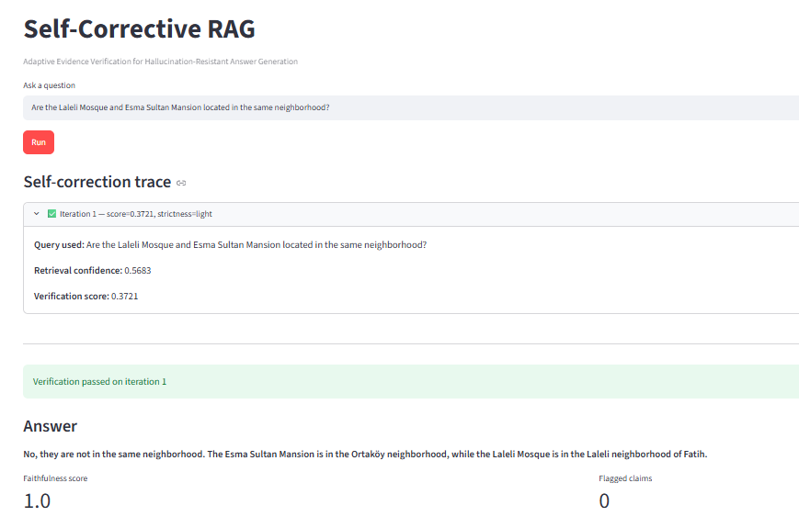
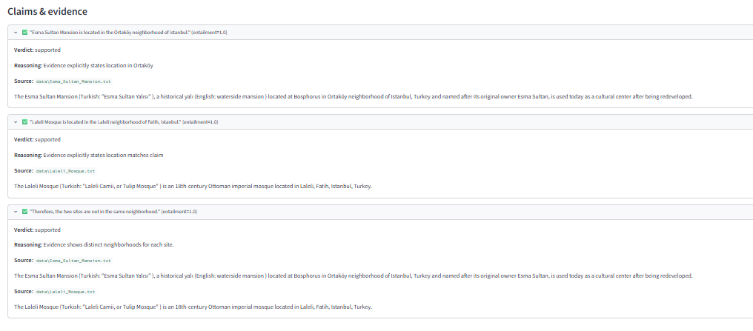
Self Corrective RAG With Adaptive Evidence Verification
Result

Slide 15
Self Corrective RAG With Adaptive Evidence Verification
Reference
Lewis et al. (2020) – Retrieval-Augmented Generation for Knowledge-Intensive NLP Tasks. Introduced the RAG approach for improving knowledge-based question answering.
Asai et al. (2024) – Self-RAG: Learning to Retrieve, Generate, and Critique through Self-Reflection. Introduced self-reflection for better retrieval and answer generation.
Yan et al. (2024) – Corrective Retrieval Augmented Generation (CRAG). Introduced corrective retrieval to handle poor or insufficient evidence.
Jeong et al. (2024) – Adaptive-RAG. Proposed selecting retrieval strategies based on question complexity.
Niu et al. (2024) – RAGTruth. Introduced a dataset for studying and detecting hallucinations in RAG systems.

Slide 16
MTech Program
Advanced Industry Integrated Programs
Jointly offered by University and LTIMindTree
Review III
Project Title II
Hierarchical Multi-Agent AI for Autonomous Task Decomposition, Planning, and Collaborative Execution
SOWMIYA C
T9954
CRESCENT COLLEGE
Knowledge partner | Implementation partner

Slide 17
Multi-Agent AI for Autonomous Task Decomposition, Planning, and Collaborative Execution
Introduction
Multi-Agent AI uses multiple intelligent agents to solve complex tasks collaboratively.
The system divides a complex task into smaller subtasks using hierarchical task decomposition.
Different agents perform planning, reasoning, and execution according to their assigned roles.
Agents communicate and share results to improve coordination and task completion.
The proposed system aims to provide autonomous, efficient, and reliable task execution.

Slide 18
Multi-Agent AI for Autonomous Task Decomposition, Planning, and Collaborative Execution
Objective
To develop a hierarchical multi-agent AI system for autonomous task solving.
To decompose complex tasks into smaller and manageable subtasks.
To assign subtasks to specialized agents based on their roles and capabilities.
To enable agents to communicate, coordinate, and share results effectively.
To achieve efficient, autonomous, and reliable task planning and execution.

Slide 19
Multi-Agent AI for Autonomous Task Decomposition, Planning, and Collaborative Execution
Module name
1. Manager Agent
Decomposes the user goal into high-level tasks.
2. Supervisor Agent
Monitors workflow and divides tasks into subtasks.
3. Worker Agent
Executes assigned tasks and generates outputs.
4. Shared Memory Module
Stores and shares information among agents.
5. Result Aggregation Module
Combines agent outputs and produces the final result.

Slide 20
Multi-Agent AI for Autonomous Task Decomposition, Planning, and Collaborative Execution
Problem Statement
Manual task planning and execution become difficult when handling complex goals.
Traditional systems lack intelligent task decomposition and autonomous coordination.
Managing multiple tasks and subtasks requires significant human effort and monitoring.
Existing approaches do not efficiently support collaborative execution among multiple agents.
There is a need for a hierarchical multi-agent system that can automatically decompose, plan, coordinate, and execute tasks with minimal human intervention.

Slide 21
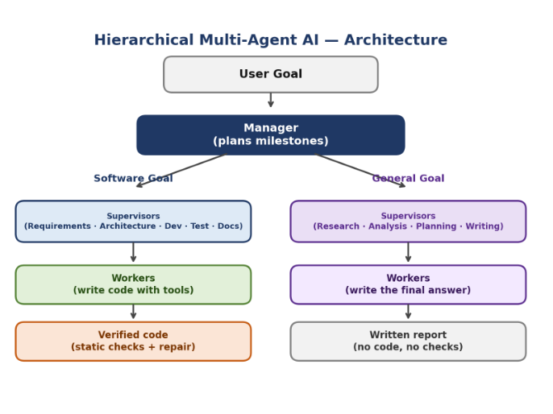
Multi-Agent AI for Autonomous Task Decomposition, Planning, and Collaborative Execution
Methodology
Step 1 - Goal Input
User provides a high-level goal to the system.
Step 2 - Task Decomposition
Manager Agent analyses the goal and creates major tasks.
Step 3 - Subtask Generation
Supervisor Agent breaks major tasks into smaller actionable subtasks.
Step 4 - Task Execution
Worker Agents execute the assigned subtasks collaboratively.
Step 5 - Result Generation
Shared Memory stores outputs and the system consolidates final results.

Slide 22
Multi-Agent AI for Autonomous Task Decomposition, Planning, and Collaborative Execution
Approach/Algorithms/Tools
Approach:
The proposed system uses a Hierarchical Multi-Agent Architecture to automatically decompose user goals into tasks and subtasks. Multiple agents collaborate through shared memory to execute tasks efficiently and generate consolidated results autonomously.
Algorithms:
Goal-Based Input Processing
Accepts a high-level goal from the user for execution.
Hierarchical Task Decomposition
Breaks complex goals into manageable tasks and subtasks.

Slide 23
Multi-Agent AI for Autonomous Task Decomposition, Planning, and Collaborative Execution
Approach/Algorithms/Tools
Algorithms:
Multi-Agent Collaboration
Enables Manager, Supervisor, and Worker agents to work together.
Shared Memory Coordination
Stores and shares task information among agents for efficient execution.
Autonomous Result Generation
Aggregates outputs from all agents and produces the final result.
Tools
Python, Streamlit, Groq API, LangChain, Python Dotenv, VS Code, Git, GitHub, Railway, Pytest

Slide 24
Multi-Agent AI for Autonomous Task Decomposition, Planning, and Collaborative Execution
Findings and Results
Complex goals were successfully divided into smaller and manageable tasks.
Multi-agent collaboration improved task coordination and execution efficiency.
Shared memory enabled smooth information exchange between agents.
The system generated structured and organized execution plans automatically.
The framework worked effectively across different domains and use cases.

Slide 25
Multi-Agent AI for Autonomous Task Decomposition, Planning, and Collaborative Execution
Conclusion
A Hierarchical Multi-Agent AI system was successfully developed and implemented.
The proposed framework automated task decomposition, planning, and execution.
The Manager, Supervisor, and Worker agents efficiently handled complex goals.
The system reduced manual effort and improved overall workflow management.
The project demonstrates the potential of multi-agent AI systems for real-world task automation.

Slide 26
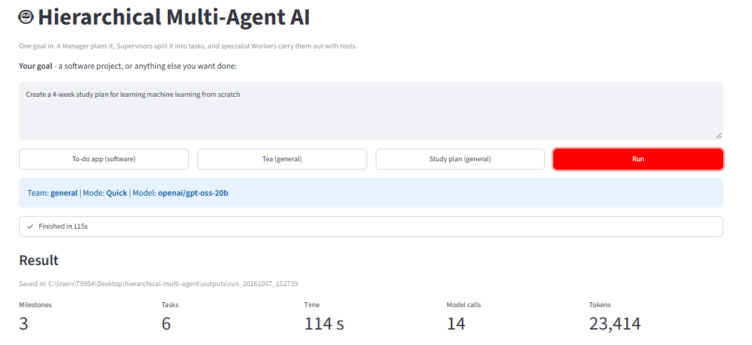
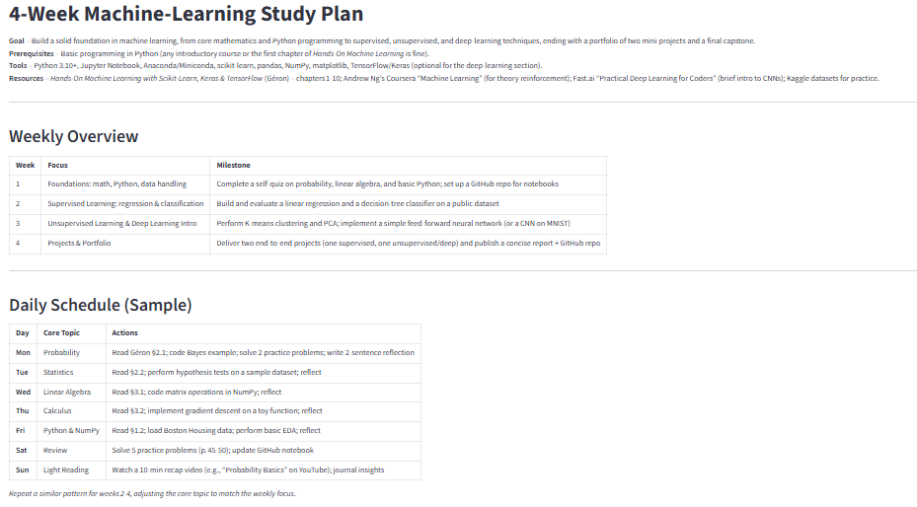
Multi-Agent AI for Autonomous Task Decomposition, Planning, and Collaborative Execution
Result

Slide 27
Multi-Agent AI for Autonomous Task Decomposition, Planning, and Collaborative Execution
Reference
1.Hong, S., et al. (2023). MetaGPT: Meta Programming for A Multi-Agent Collaborative Framework. arXiv.
2.Wu, Q., et al. (2023). AutoGen: Enabling Next-Gen LLM Applications via Multi-Agent Conversation. arXiv.
3.Prasad, A., et al. (2024). ADaPT: As-Needed Decomposition and Planning with Language Models. Findings of NAACL 2024.
4.Zhang, C., et al. (2025). Planning with Multi-Constraints via Collaborative Language Agents. Proceedings of COLING 2025.
5.Xu, T., et al. (2026). Verification-Aware Planning for Multi-Agent Systems. Proceedings of EACL 2026.

